Slide 1
CATastrophic Shootout:
Art-Bible (α)
Feline Firepower

Slide 2
Guns
What we have so far:

Slide 3
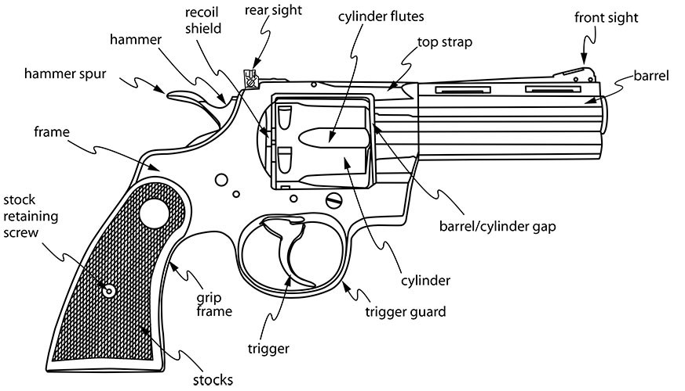
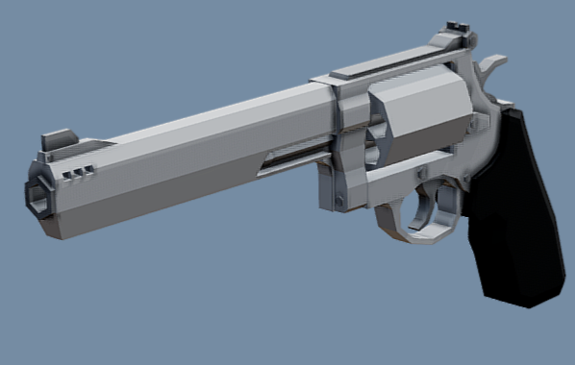
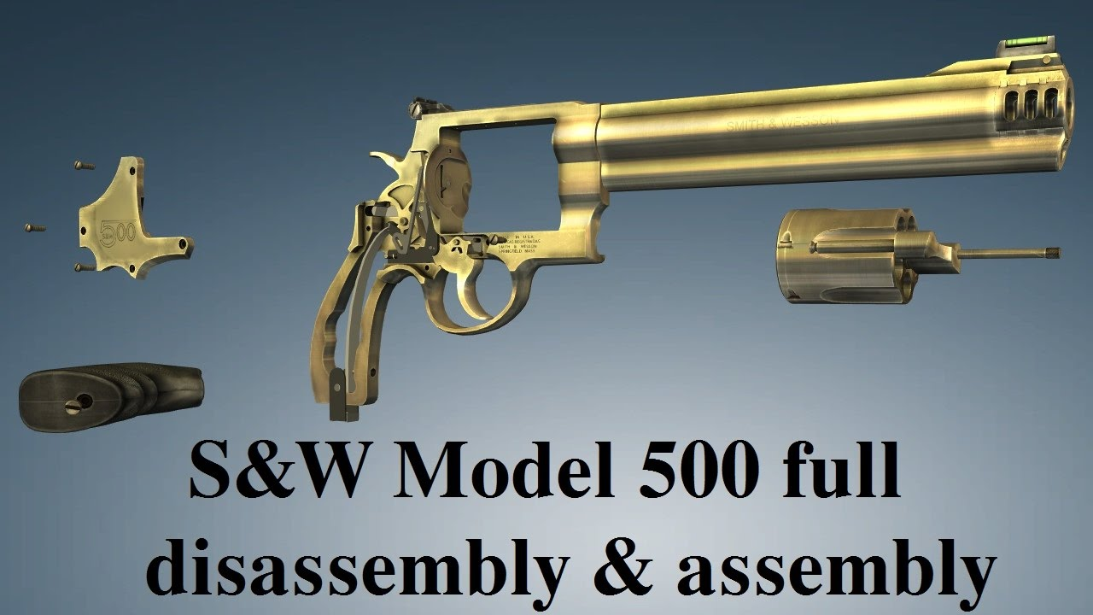
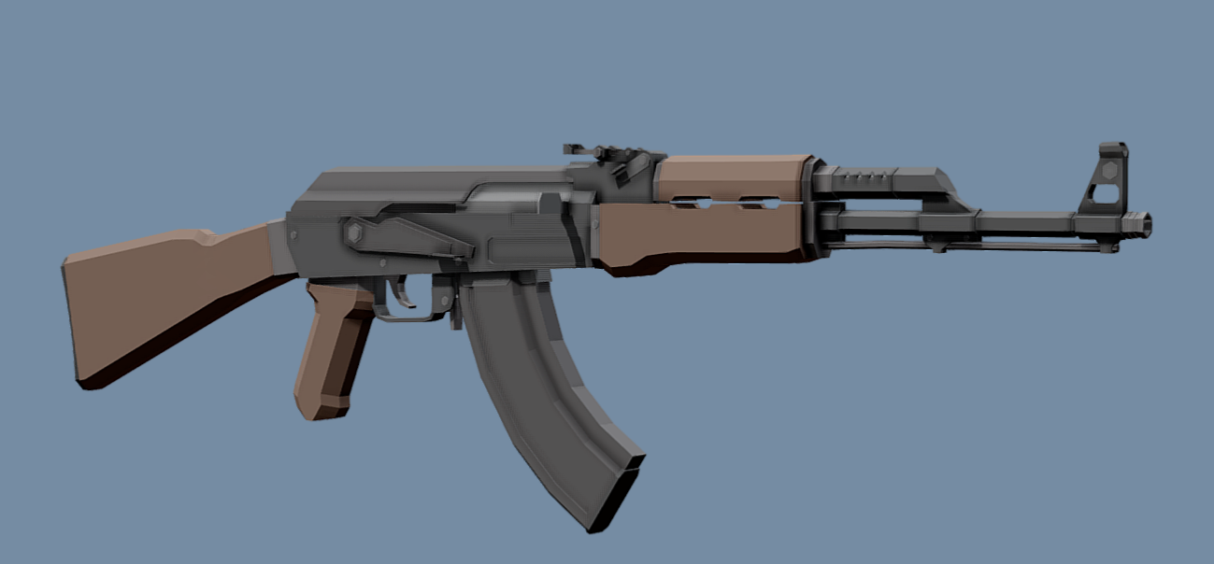
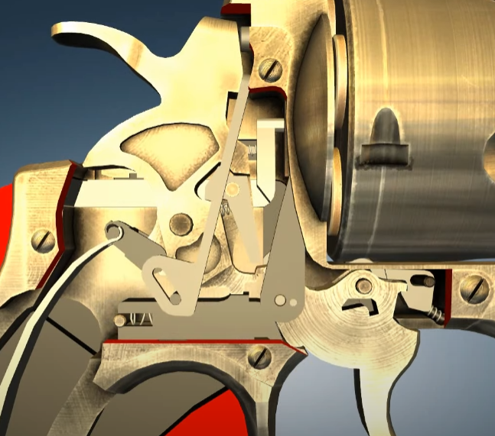
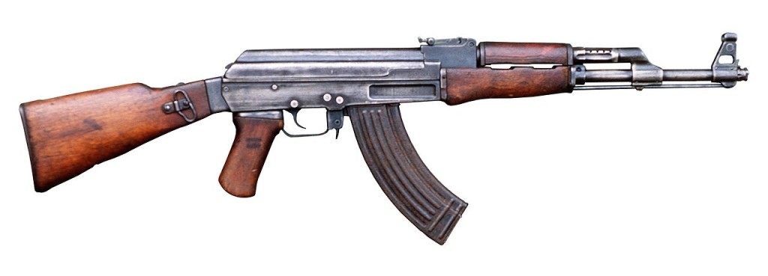
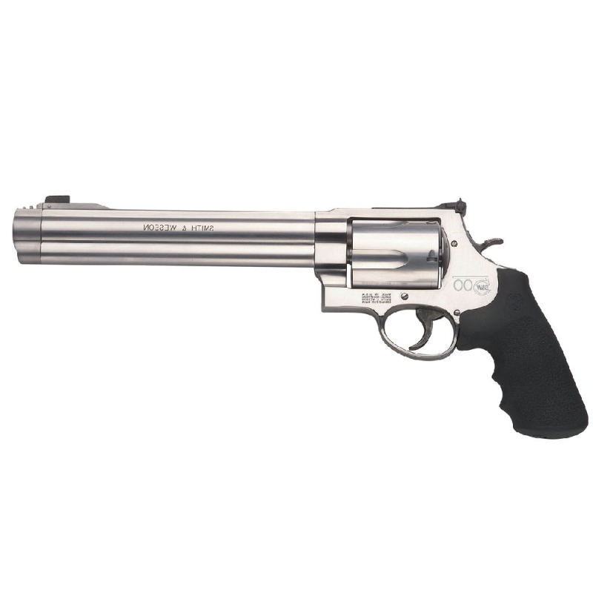
Gun References:
-> Realistic Gun Models
-> actually Functioning parts for animations
-> Understand how guns work mechanically
-> to be able to make the animations will ‘feel’ powerful and realistic
-> Low Poly but detailed
-> Relatively simple textures
-> higher Poly-Count than most other assets
-> less negative impact on performance
-> will be stylized with shader and color palettes cohesively

Slide 4
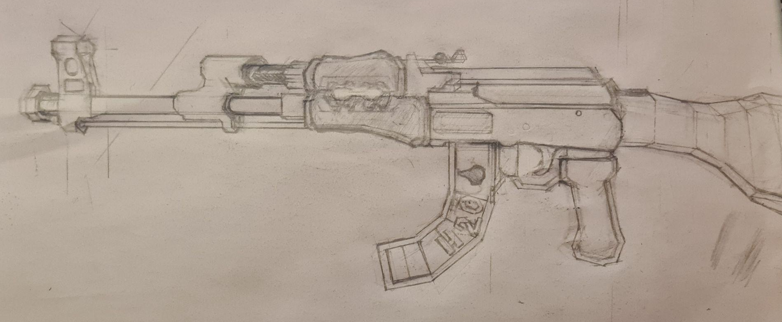
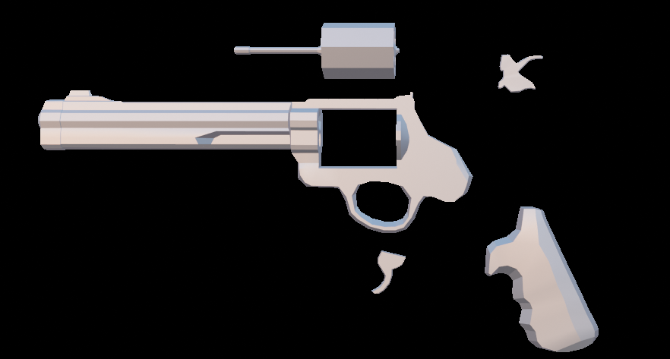
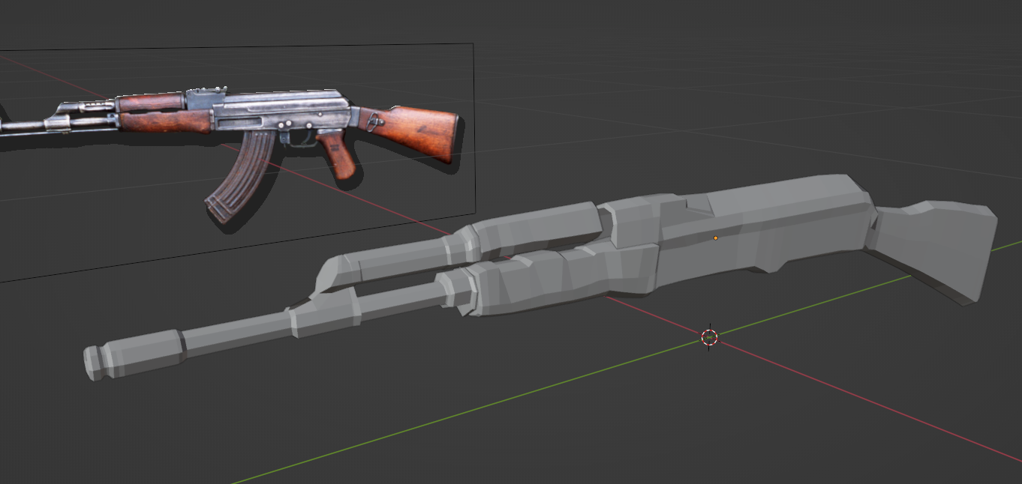
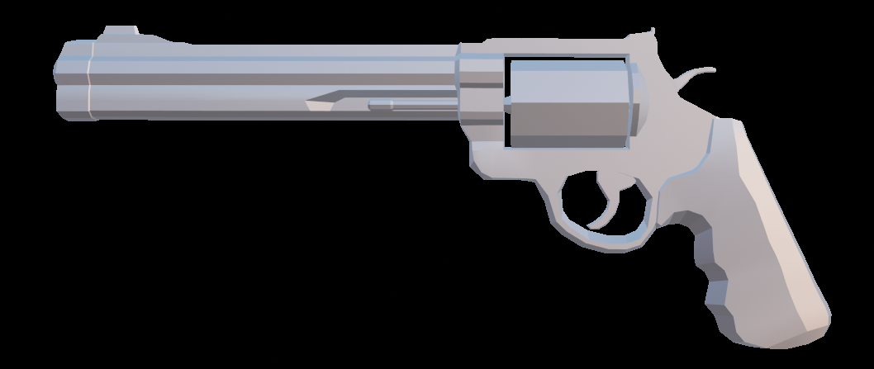
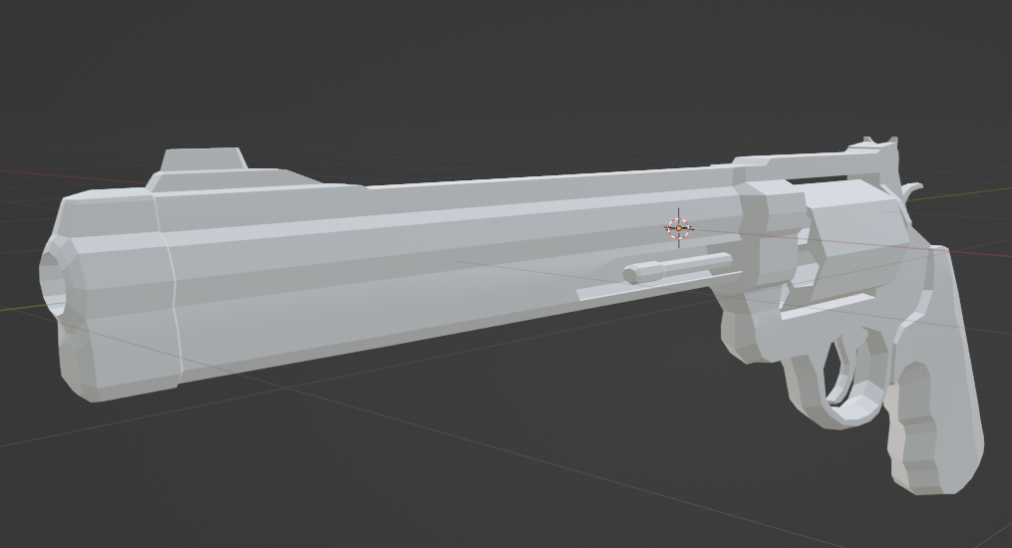
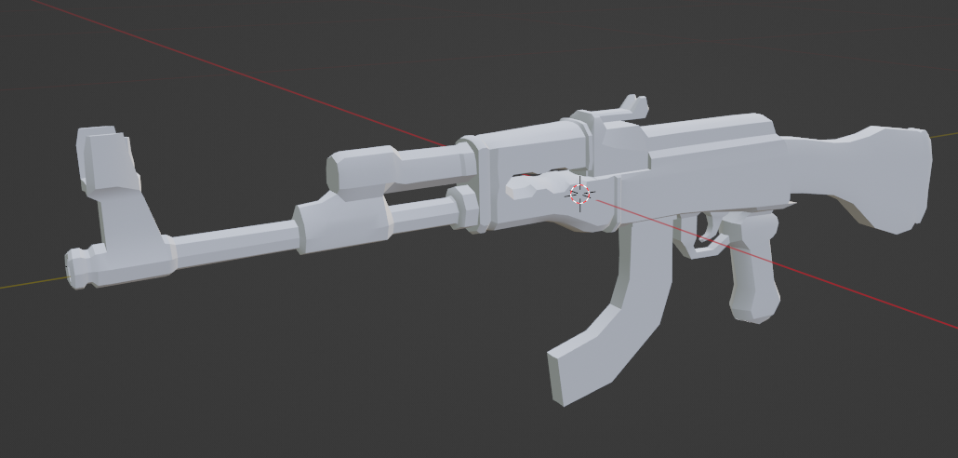
Gun Models and Concept Art:
-> Due to time constraints and a lack of team members, the Weapons were mostly iterated upon while modeling.
-> Concept Art and Studies were done regardless however, due to the priority of well modeled and animated weapons
-> For us, getting the weapons to look and feel right is one of, if not the most important part of an FPS-shooter
-> (Higher level of Detail and Higher Polygon Count than Environment)
AK - (Verts: 1784 | Tris: 3534)
Revolver - (Verts: 1149 | Tris: 2379)

Slide 5
Environment
What we have so far:

Slide 6
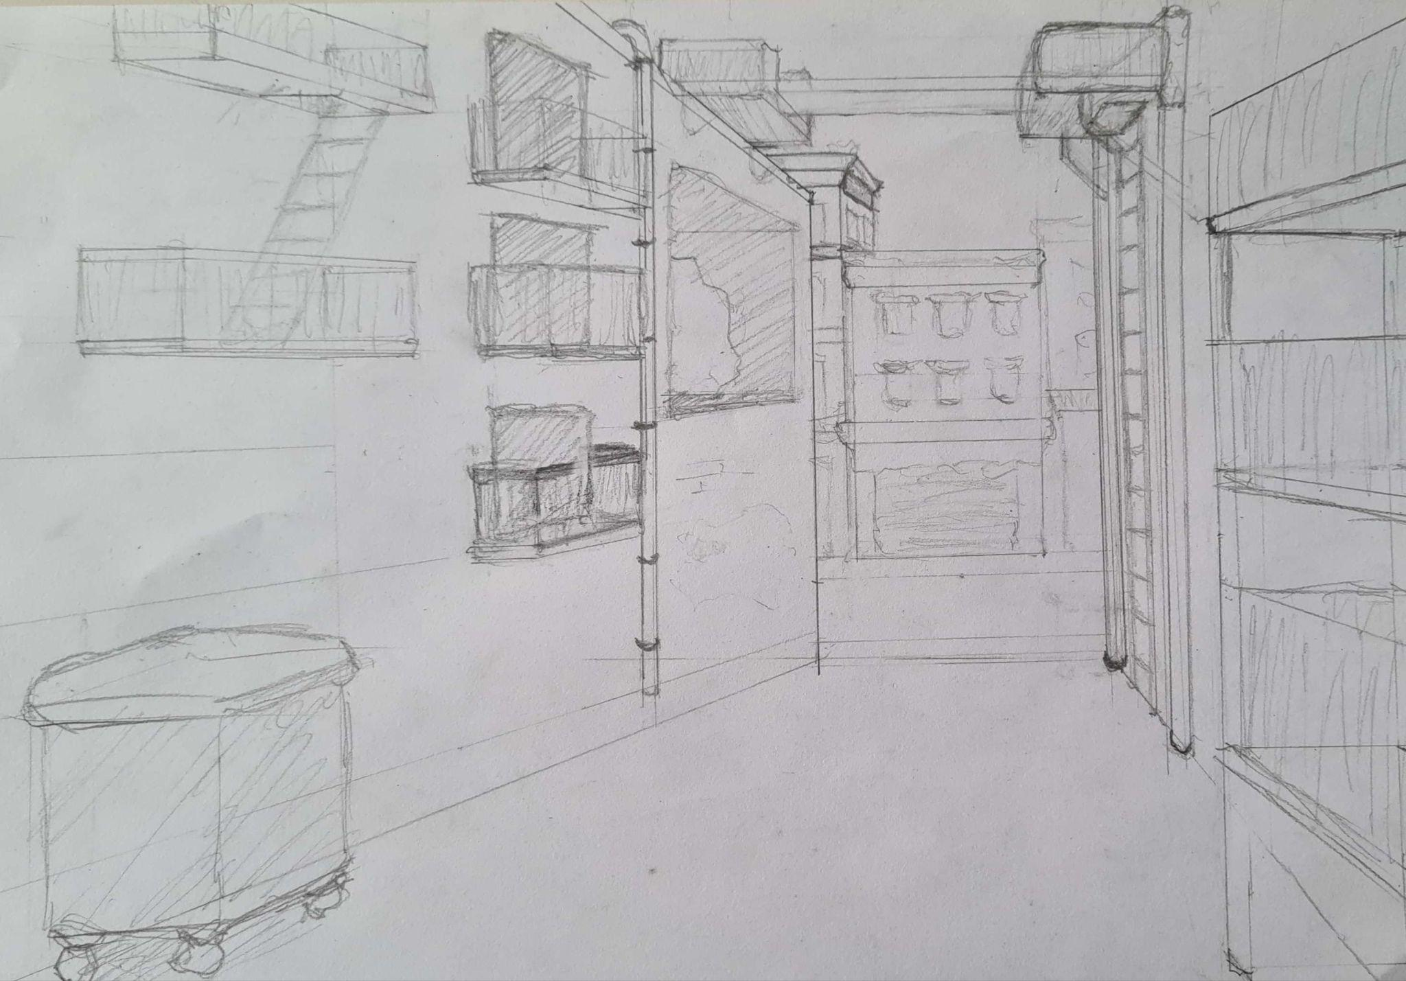
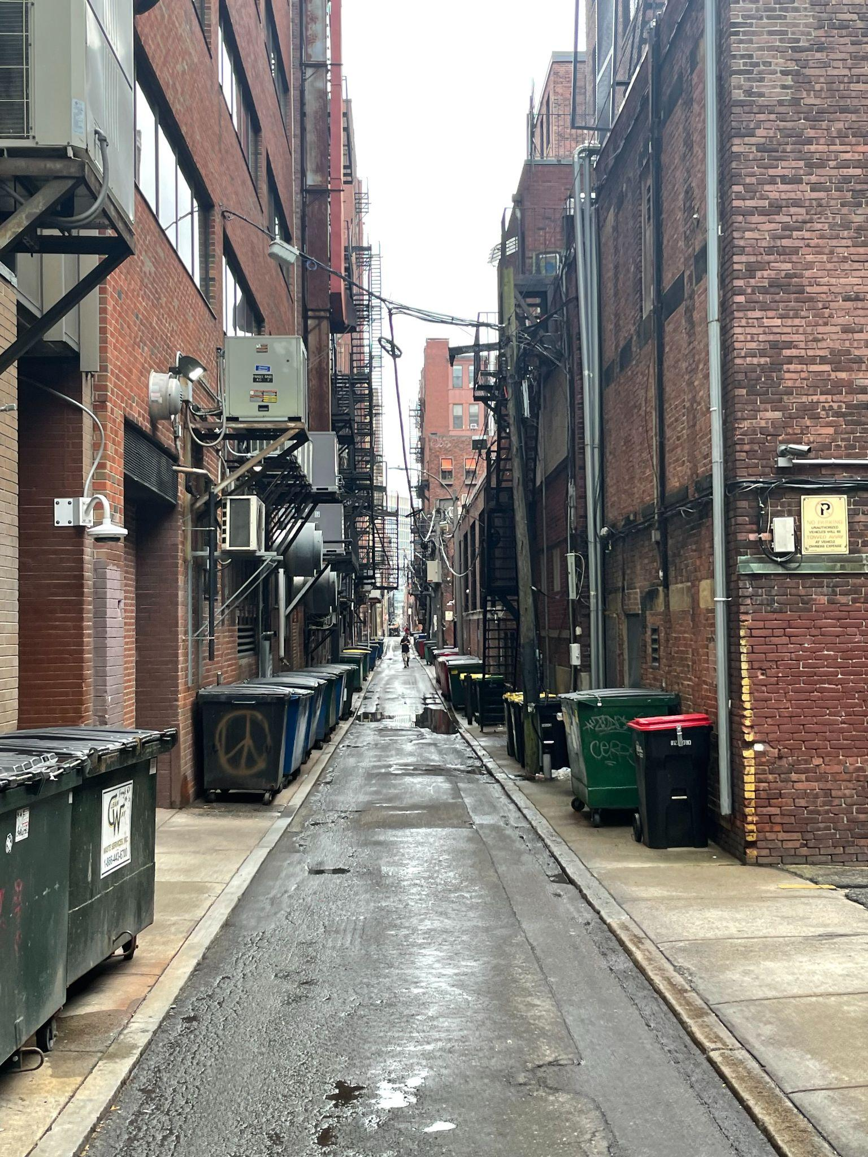
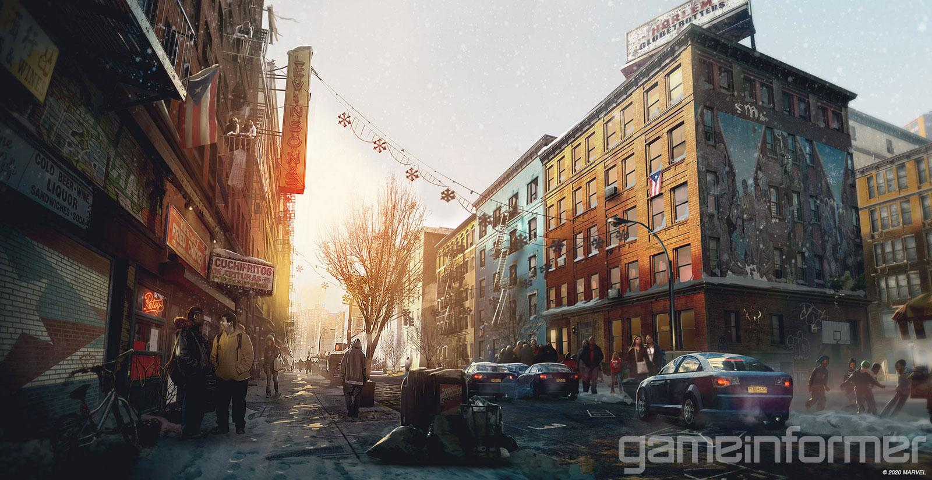
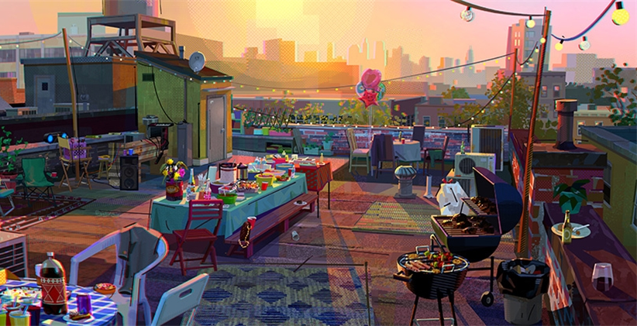
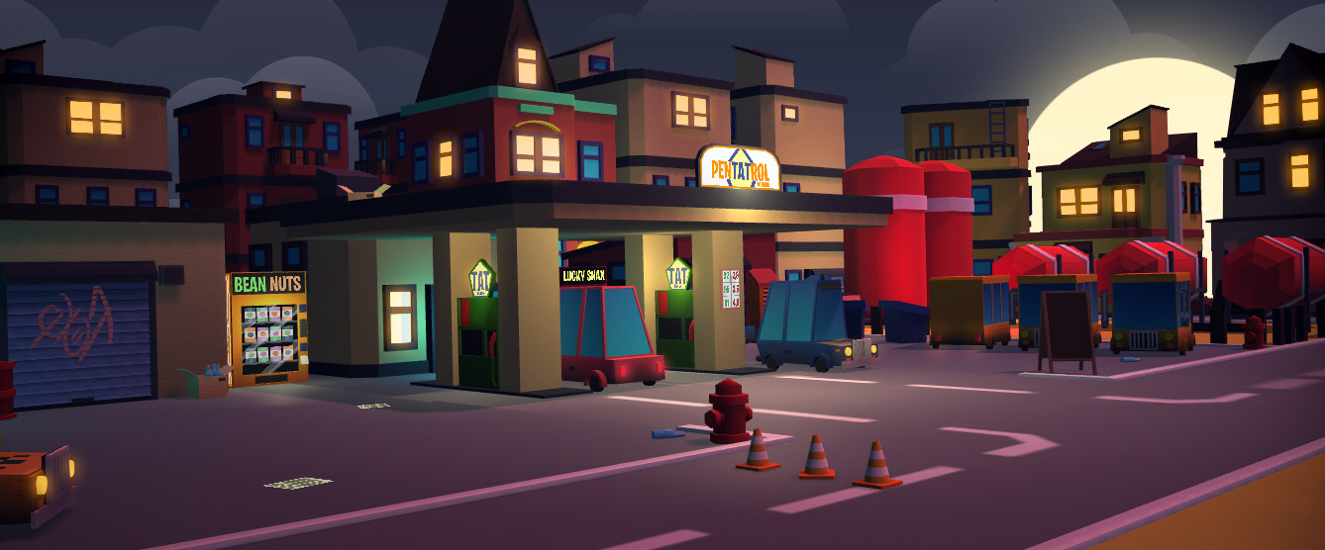
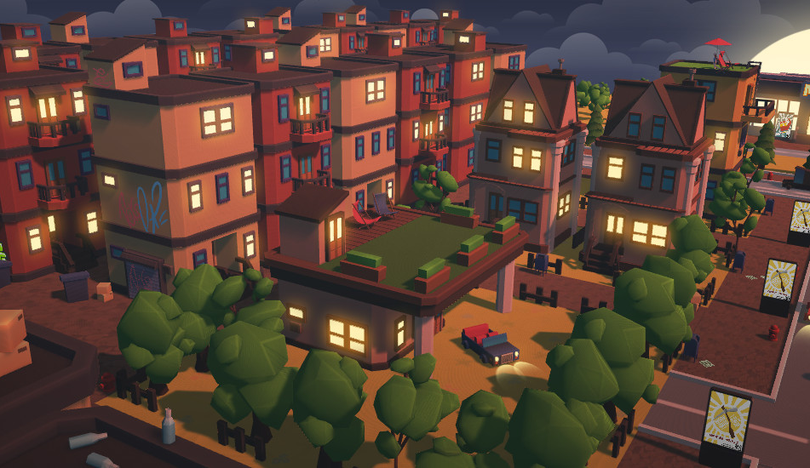
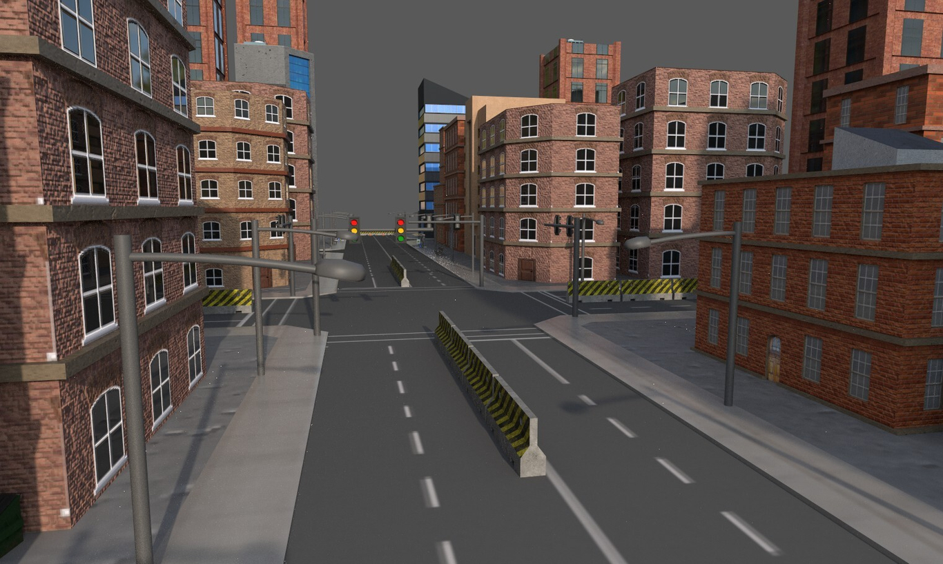
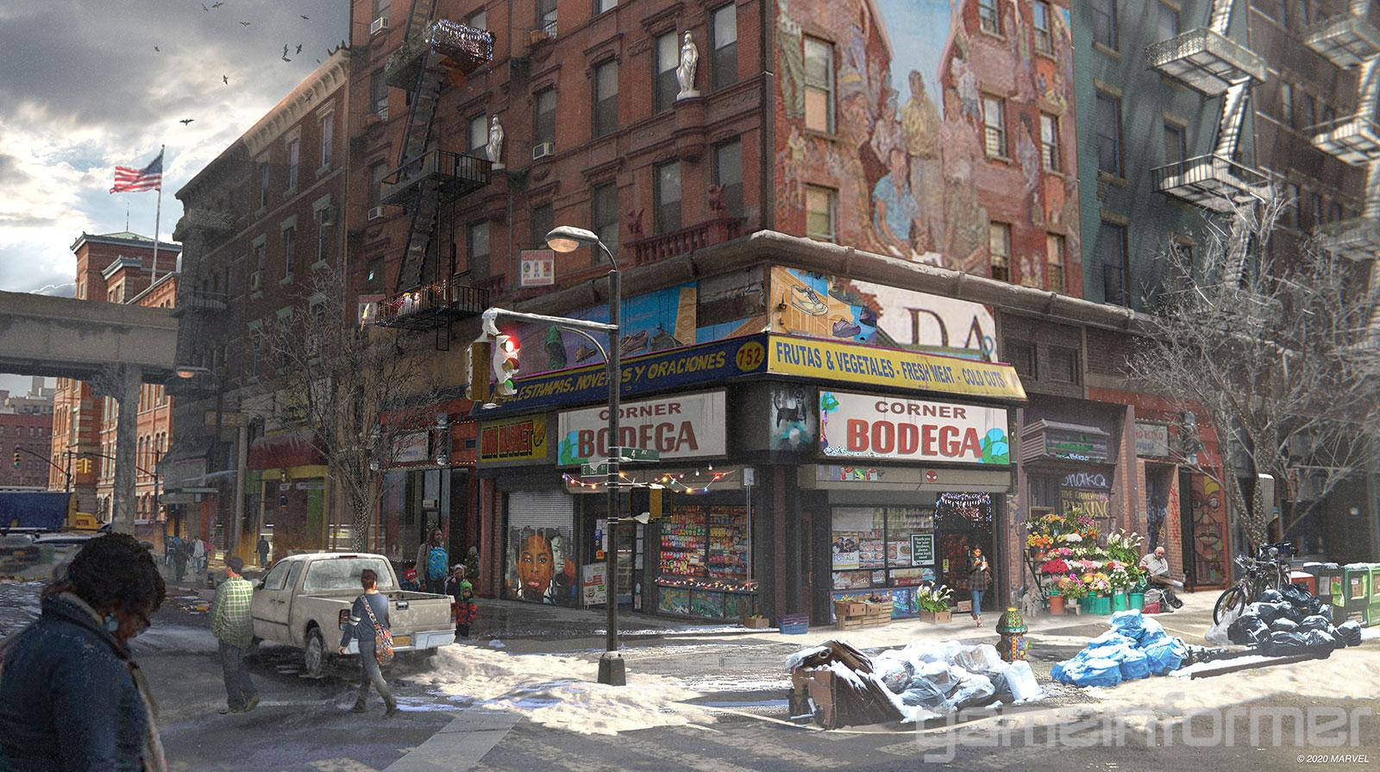
Env. Moodboard:

Slide 7
Miscellaneous
What we have so far:

Slide 8
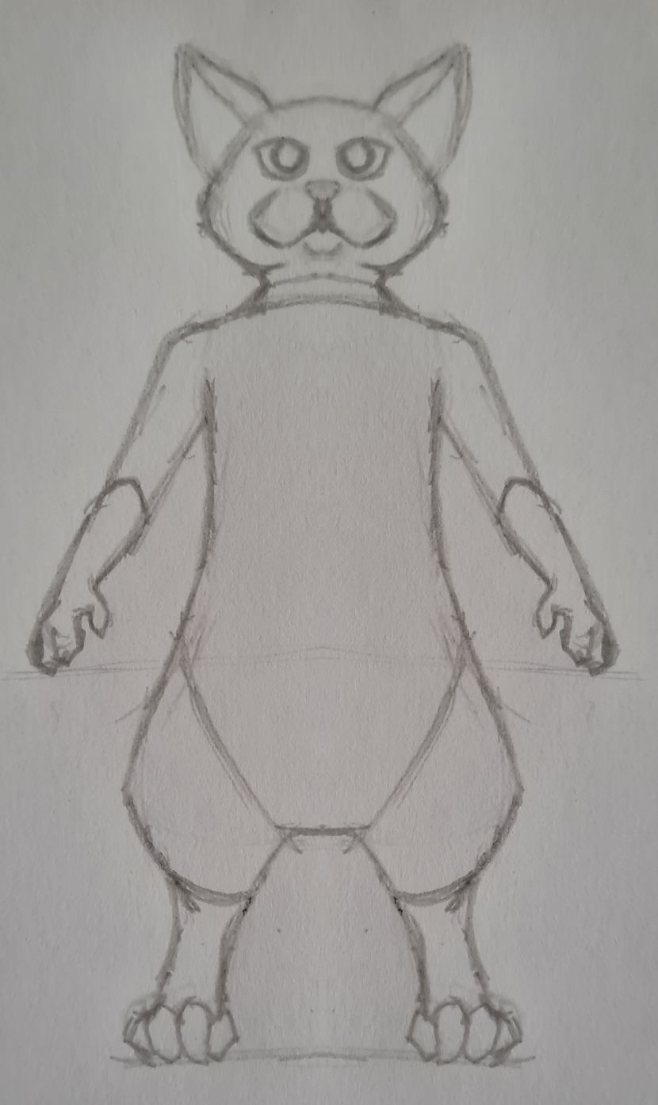
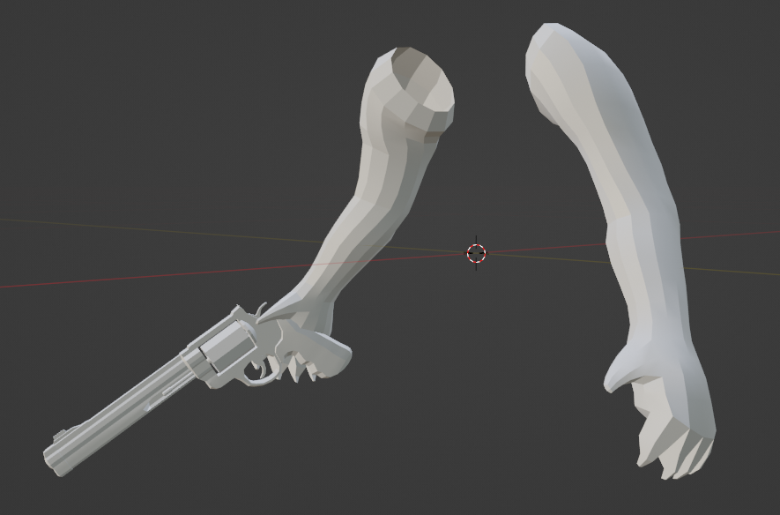
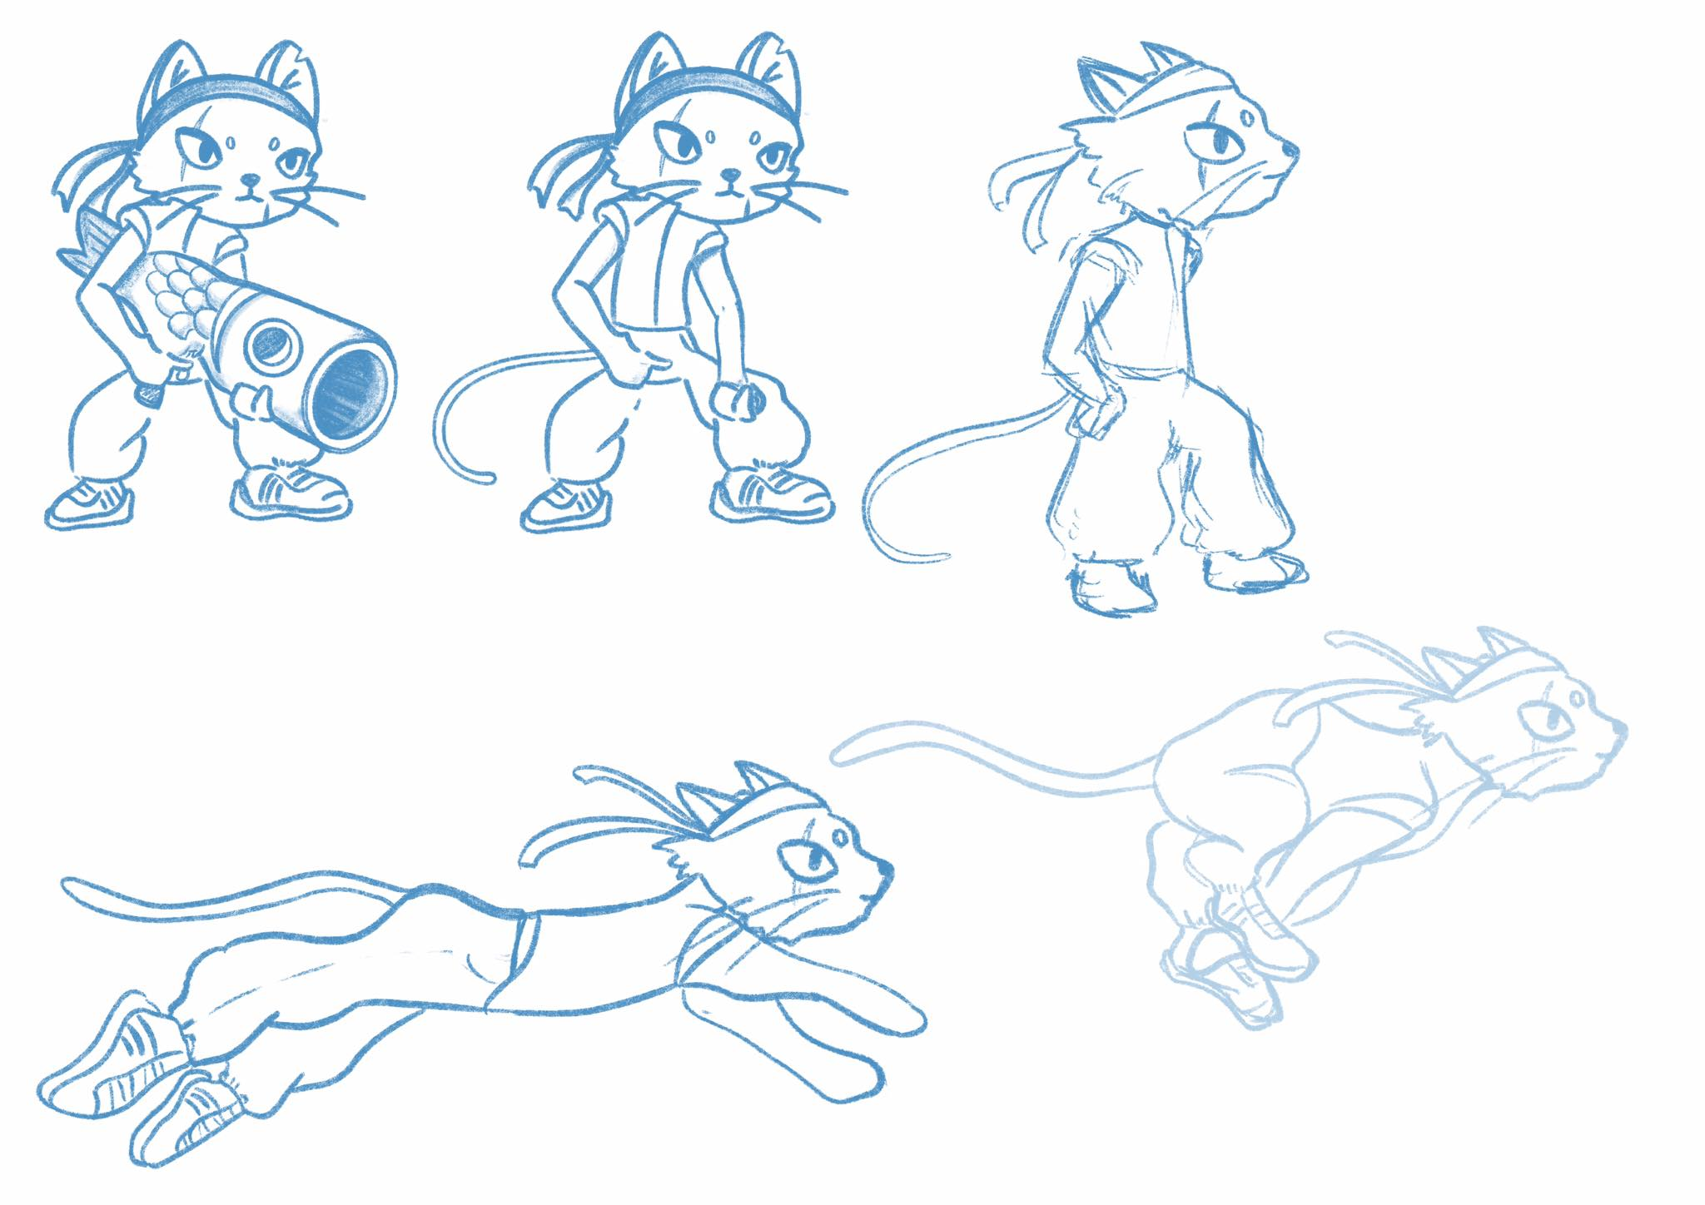
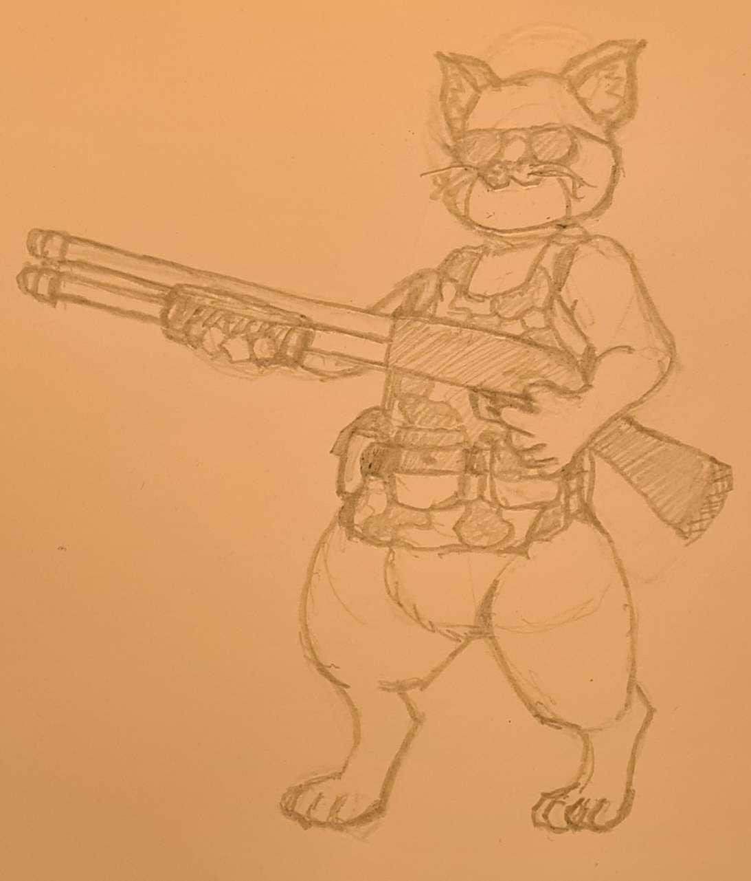
Character Design:
First Person Model:
Concept Art:
-> FPS-Paws were created in order for us to be able to start our animation, and make progress with implementing our weapons
-> moved away from more cutesy art-style, to not cause ludonarrative dissonance
-> first few rudimentary steps towards our Main Character
->to be iterated upon
-> Semi-realistic proportions, Low-Poly, cartoonish art-style is the goal
-> Texturing will be simplistic, most of the aesthetic will come from the lighting, shader (cell/toon shader) and color cohesion (still WIP)
FPS-Model - (Verts: 646 | Tris: 1264)

Slide 9
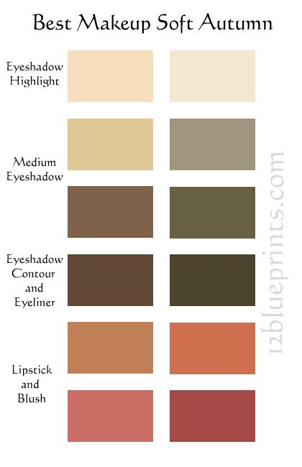



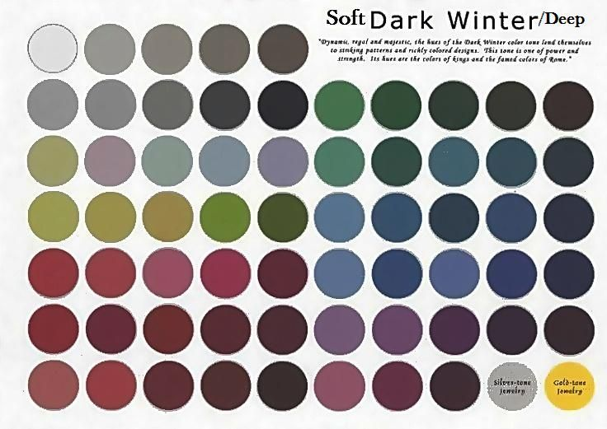

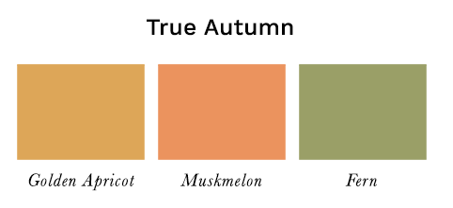
Color Palette
ENVIRONMENT:
PLAYER:
ENEMY:

Slide 10
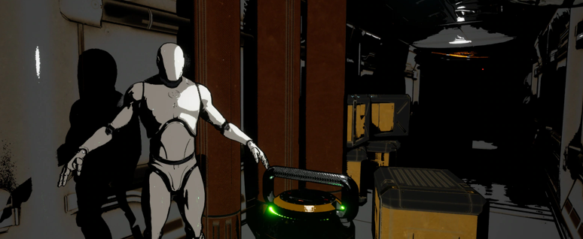
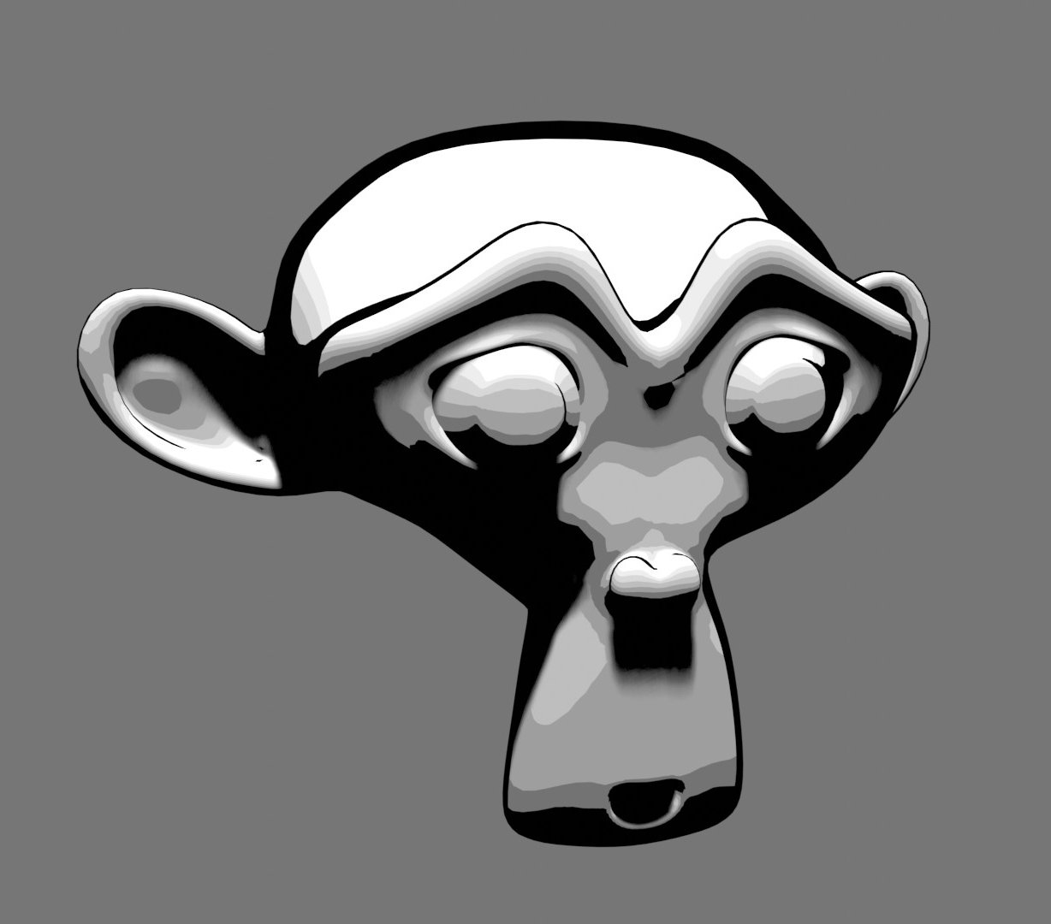
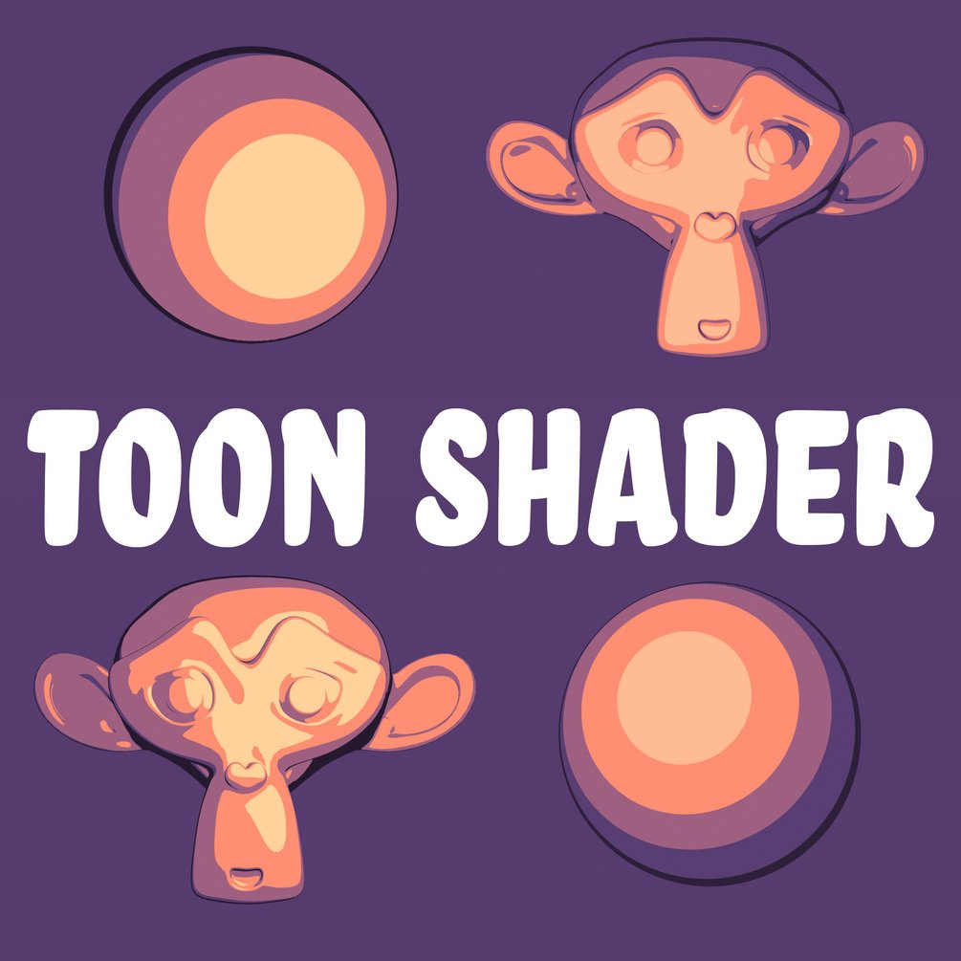
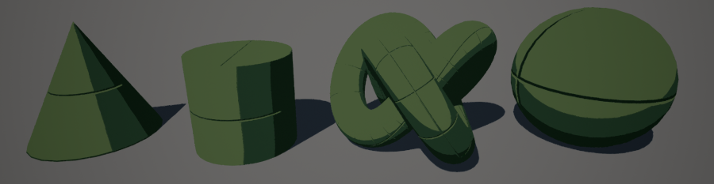

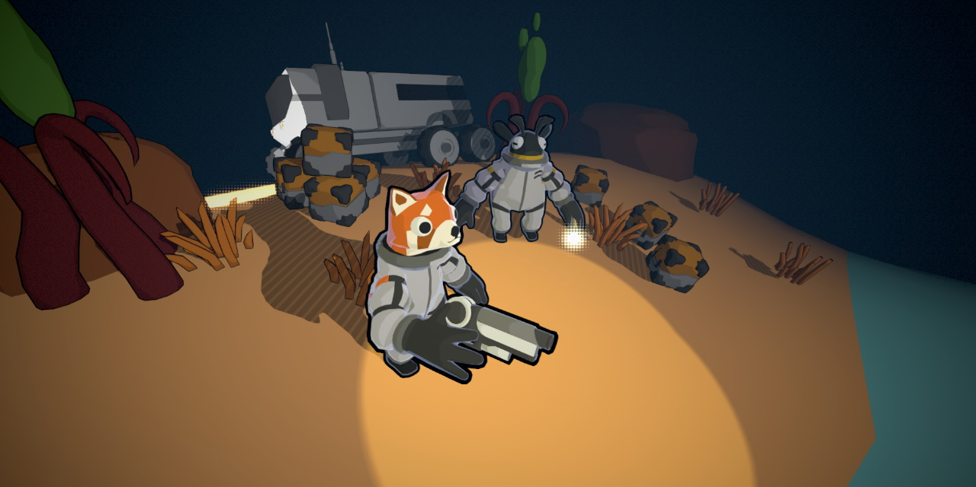
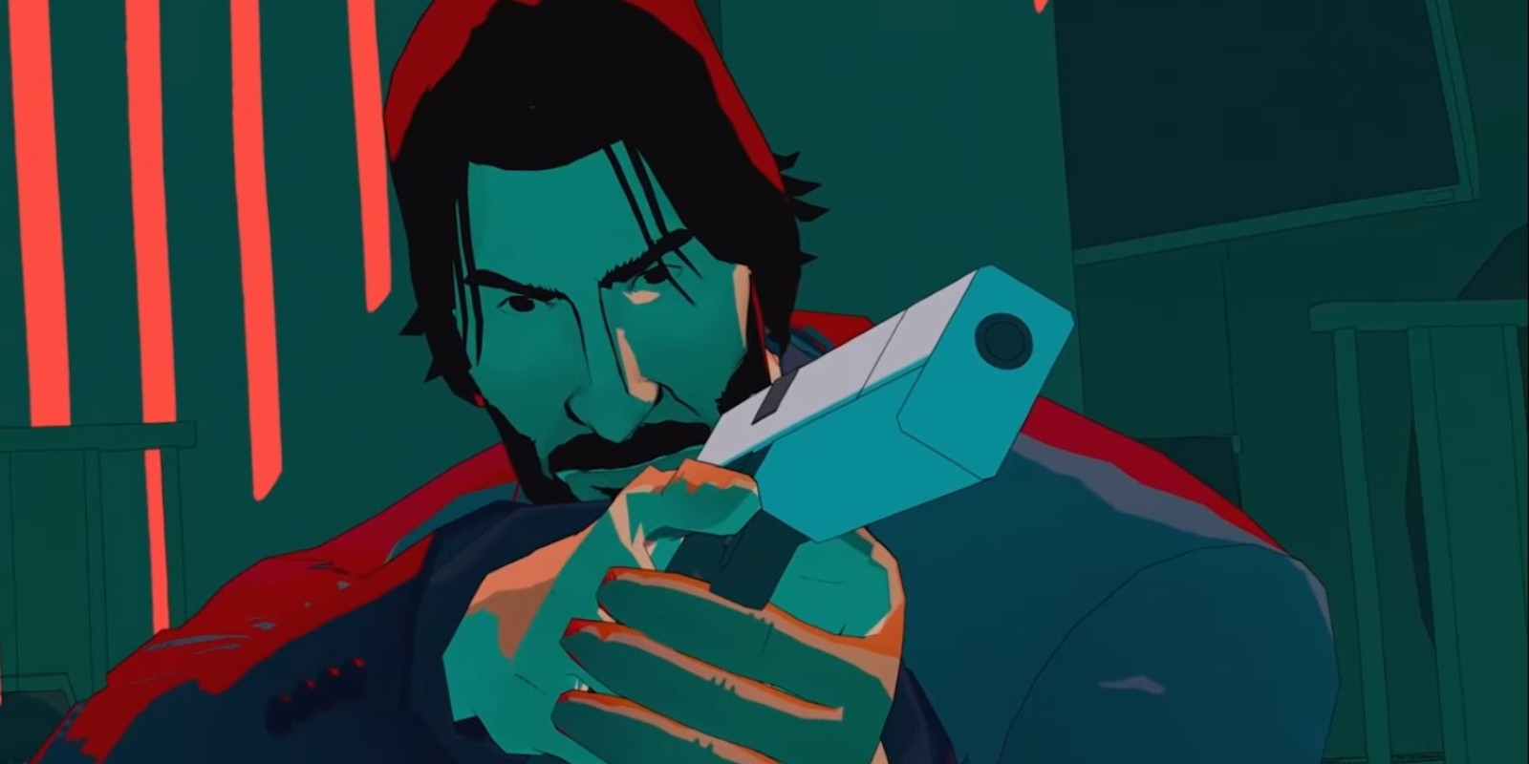
Shader
Moodboard:

Slide 11
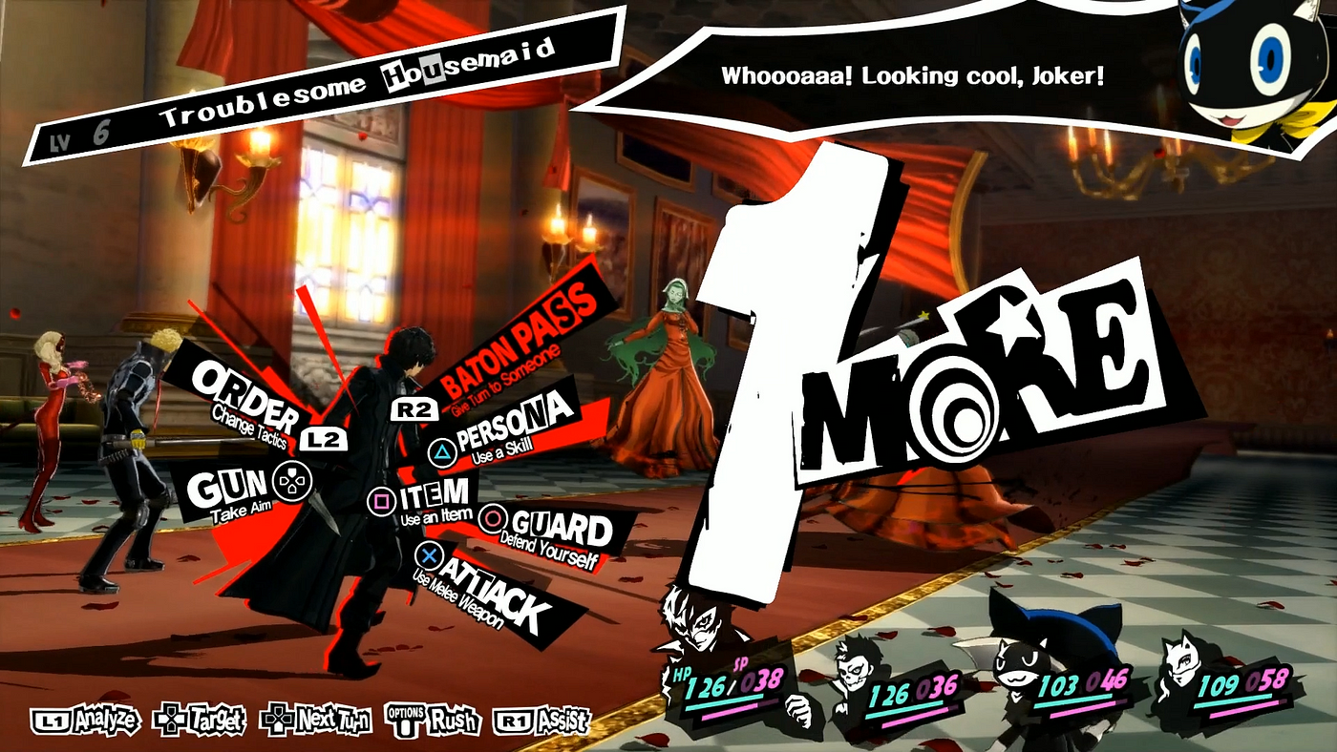
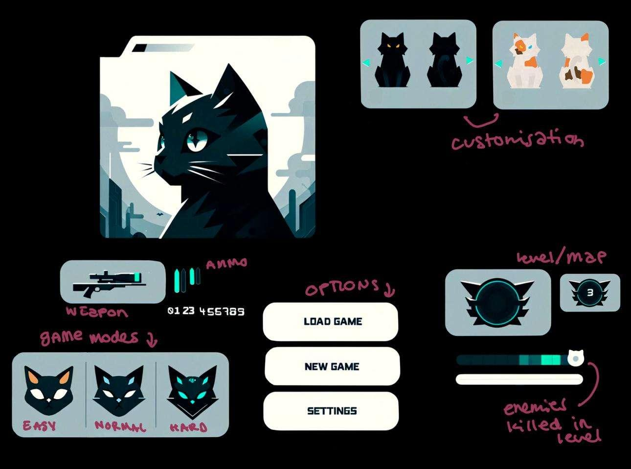
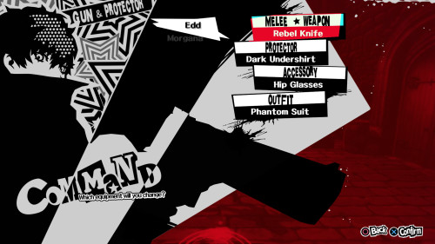
User Interface:
Inspiration
Concept Art

Slide 12
For your attention and time thus far, we at Catastrophic Creations have only one thing left to say:
Thank you!

